Slide 1
CMP105 – Games Programming Game
By Fraser Barker(1600196)

Slide 2
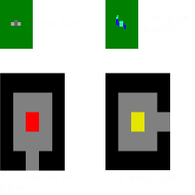
What is my game?
Type: 2D Top Down Shooter.
Aim: Progress through each level by reaching the marked “goal” zone as given in the objective screen while fending off enemies. You will gain a point for each enemy killed (although the primary goal is to reach the end zone).

Slide 3
Major Mechanics
Player/Enemy/Bullet Movement
Player moves via keyboard inputs.
Enemies move via a vector between itself and the player.
Bullets move via a vector between its spawn(players location) and its target (cursor location).
Player/Enemy/Bullet Rotation
Player is rotated based on the mouse location.
Enemies are rotated based on the players location.
Bullets are rotated based on the cursors location.
Collision Detection/Resolution
Between Player/Wall, Player/Enemy, Enemy/Wall, Enemy/Bullet & Bullet/Wall.
Spawning (Enemy/Bullet/Blood via Managers)

Slide 4

Controls

Slide 5
Major Classes
Player
Cursor
Contains the variables which are important in the game. (Health, Bullets, Clips and Zombies Killed).
Affected by the keyboard (W, A, S, D) for movement and the mouse (Left Click to fire the weapon, Position sets the players rotation.)
Has animated sprite.
Although it is responsible for the rotation of the player and the bullets it is a pretty basic class as it really only offers a new target cursor to replace the default mouse cursor.
Has effects on players rotation, bullets target.

Slide 6
Major Classes continued…
Games
Enemy/Bullet/Blood Managers
Collates all other classes together to form a playable level/game.
Contains the world the player moves about in.
Is responsible for ALL collision detection. (Player/Wall, Player/Enemy, Enemy/Wall, Enemy/Bullet & Bullet/Wall.)
Is responsible for enemy/bullet spawns.
Is responsible for the setup, updating, spawning, rendering and death checking of their respective class.
Contains a vector of class type (Enemy/Bullet/Blood) and manipulates each one based on its constructor.

Slide 7
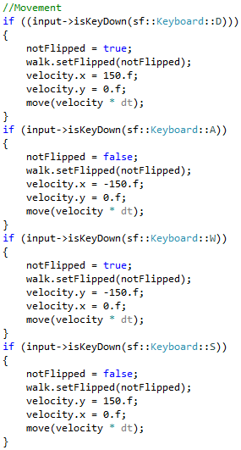
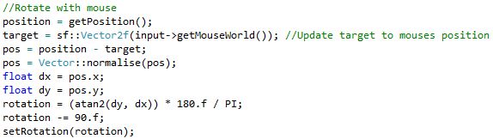
Major Mechanics
Player Movement
Player Rotation
Based on keyboard inputs (W,A,S,D).
Alters the velocity of the player.
Rotated via the mouse position within the world.
A vector which subtracts the target(mouse position) from the players position is normalised and given to the atan2 function. This returns the principal value of an arc tangent which is multiplied by 180/Pi and then sets the rotation by the given value.
Changes what way the animation is played depending on whether or not the player is flipped.
Alters the velocity of the player based on certain key presses.

Slide 8
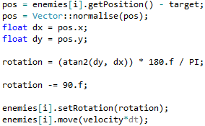
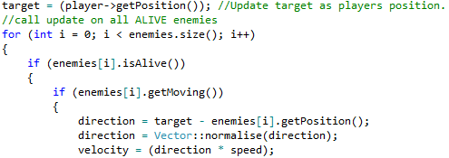
Major Mechanics 2
Enemy Movement
Enemy Rotation
Will only move if a collision between the player and enemies bounding circle has been detected, setting the enemies moving bool to true.
Players position is constantly updated so the enemies keep moving towards the player.
The velocity is based on the vector created between the player and the enemy and a given speed.
Essentially the same as the players rotation only that the target is now the player.

Slide 9
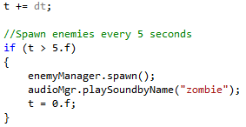
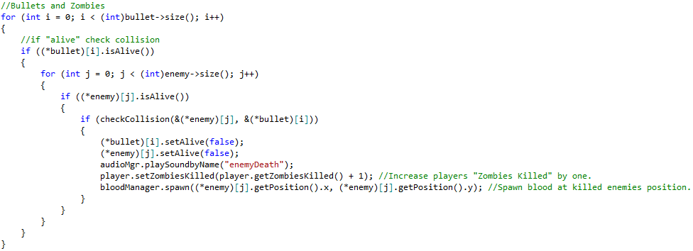
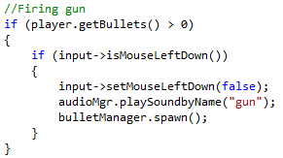
Major Mechanics 3
Spawning (Enemy/Bullet/Blood via Managers)
Enemy
Blood
Bullet
Each element has its own conditions to be spawned. Enemies are spawned every 5 seconds and are given a random location on the map. Bullets are spawned when the player fires their weapon and they originate from the players location. Blood is spawned at the “killed” enemies location.

Slide 10
Major Mechanics 4
Collision Detection
Collision Resolution
AABB
Player/Enemy & Wall
Bounding boxes are created for each sprite.
Game.cpp runs a collision check between given sprites.
Used mainly for Player/Wall collisions but is also used for Bullet/Enemy/Wall collisions.
The resolution for wall collision is the same for the player and the enemy.
A vector is created and used to determine whether the collision is on the X or Y axis.
The position is then set based on the axis of collision and the width/height of the sprites.
Bounding Circle
Bounding circles are mainly used for when enemies “attack” the player (Reducing the players health).
Larger radius detection is used to make enemies move.
Bullet & Wall
Much simpler resolution in that if a collision is detected the colliding bullet is set to “dead”.

Slide 11
References
Inspiration: Left 4k Dead
Art: Self done
Music: http://www.bensound.com/
Sound Effects:
http://soundbible.com/
http://www.bfxr.net/
http://www.sounddogs.com/sound-effects.asp

